Slide 1








Lesson 1. HTML Attribute vs DOM Property

Slide 2
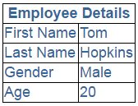

Angular Attribute Binding
What is Attribute Binding
Interpolation and Property binding deal with binding Component class properties to HTML element properties and NOT ATTRIBUTES
But not all HTML element attributes have corresponding properties. For example, coslpan attribute does not have a corresponding property
In situations like this we want to be able to bind to HTML element attributes
Hence, Angular provided Attribute Binding
Attribute Binding Examples

Slide 3
Q & A
Contact:rashmipawaskar@synergetics-india.com

Slide 4
Thank You

